Slide 1



Final Project Presentation
Akos Madarasz & Bartosz Lachowicz

Slide 2
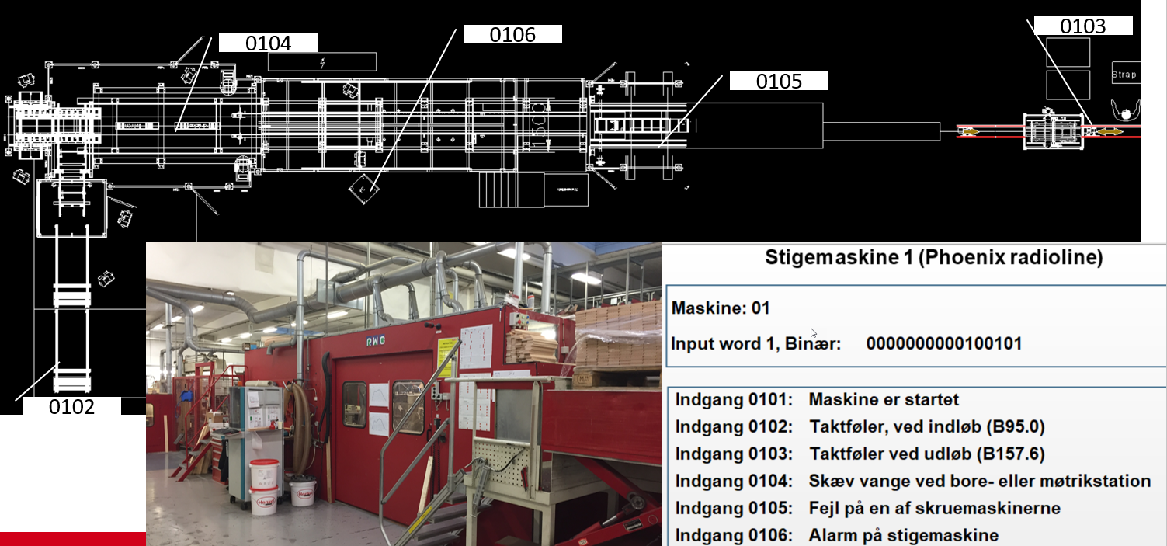
Dolle Introduction
What is Dolle?
What do they do?
Pioneers in Industry 4.0

Slide 3
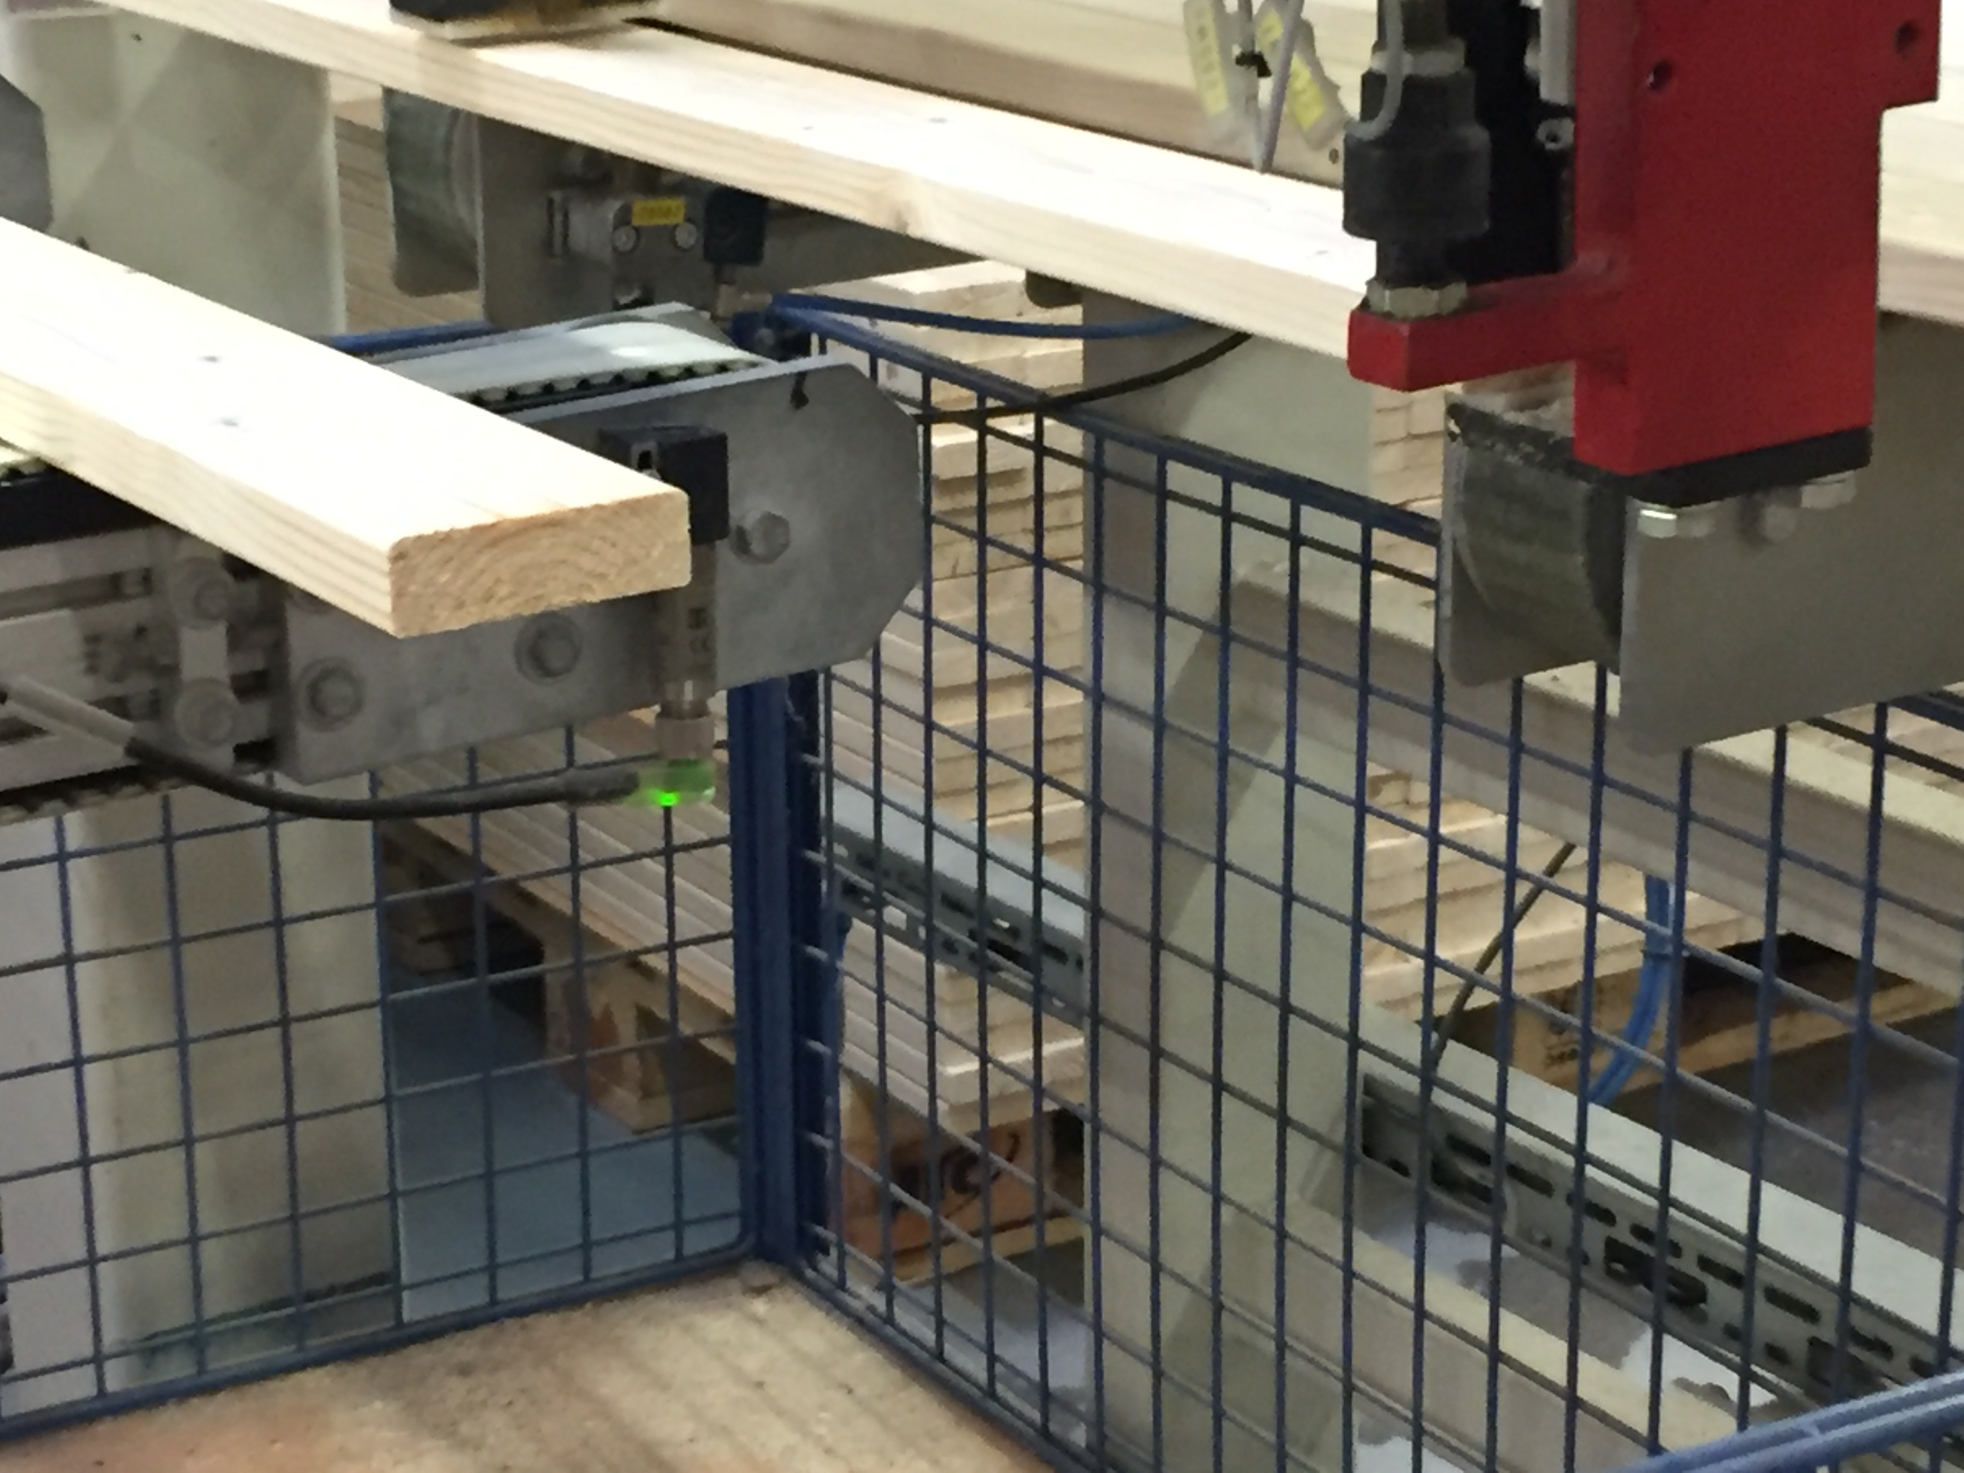
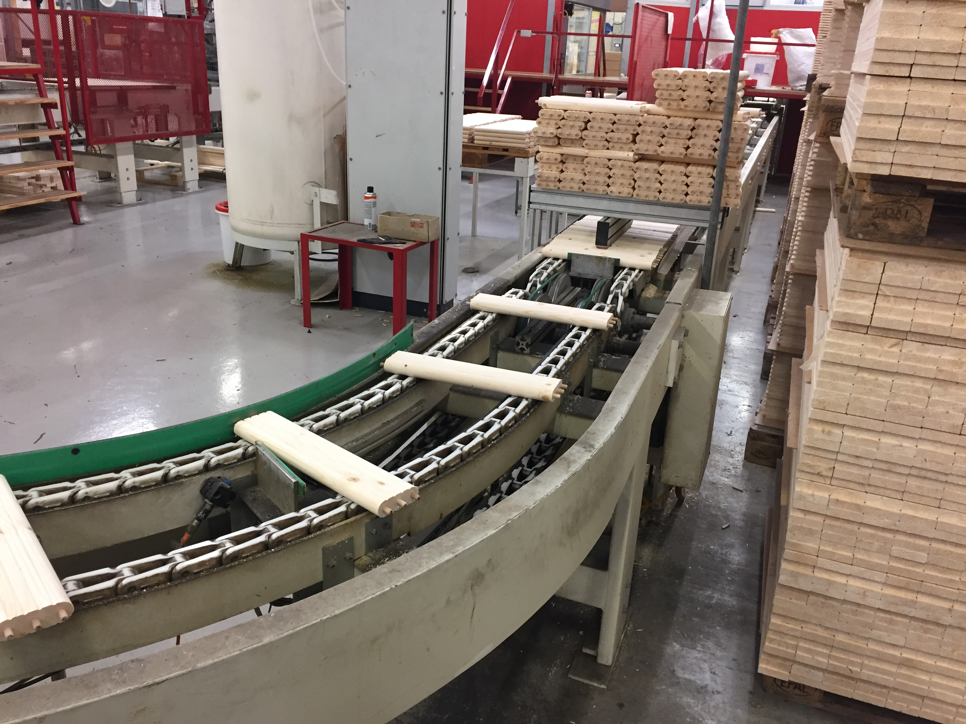
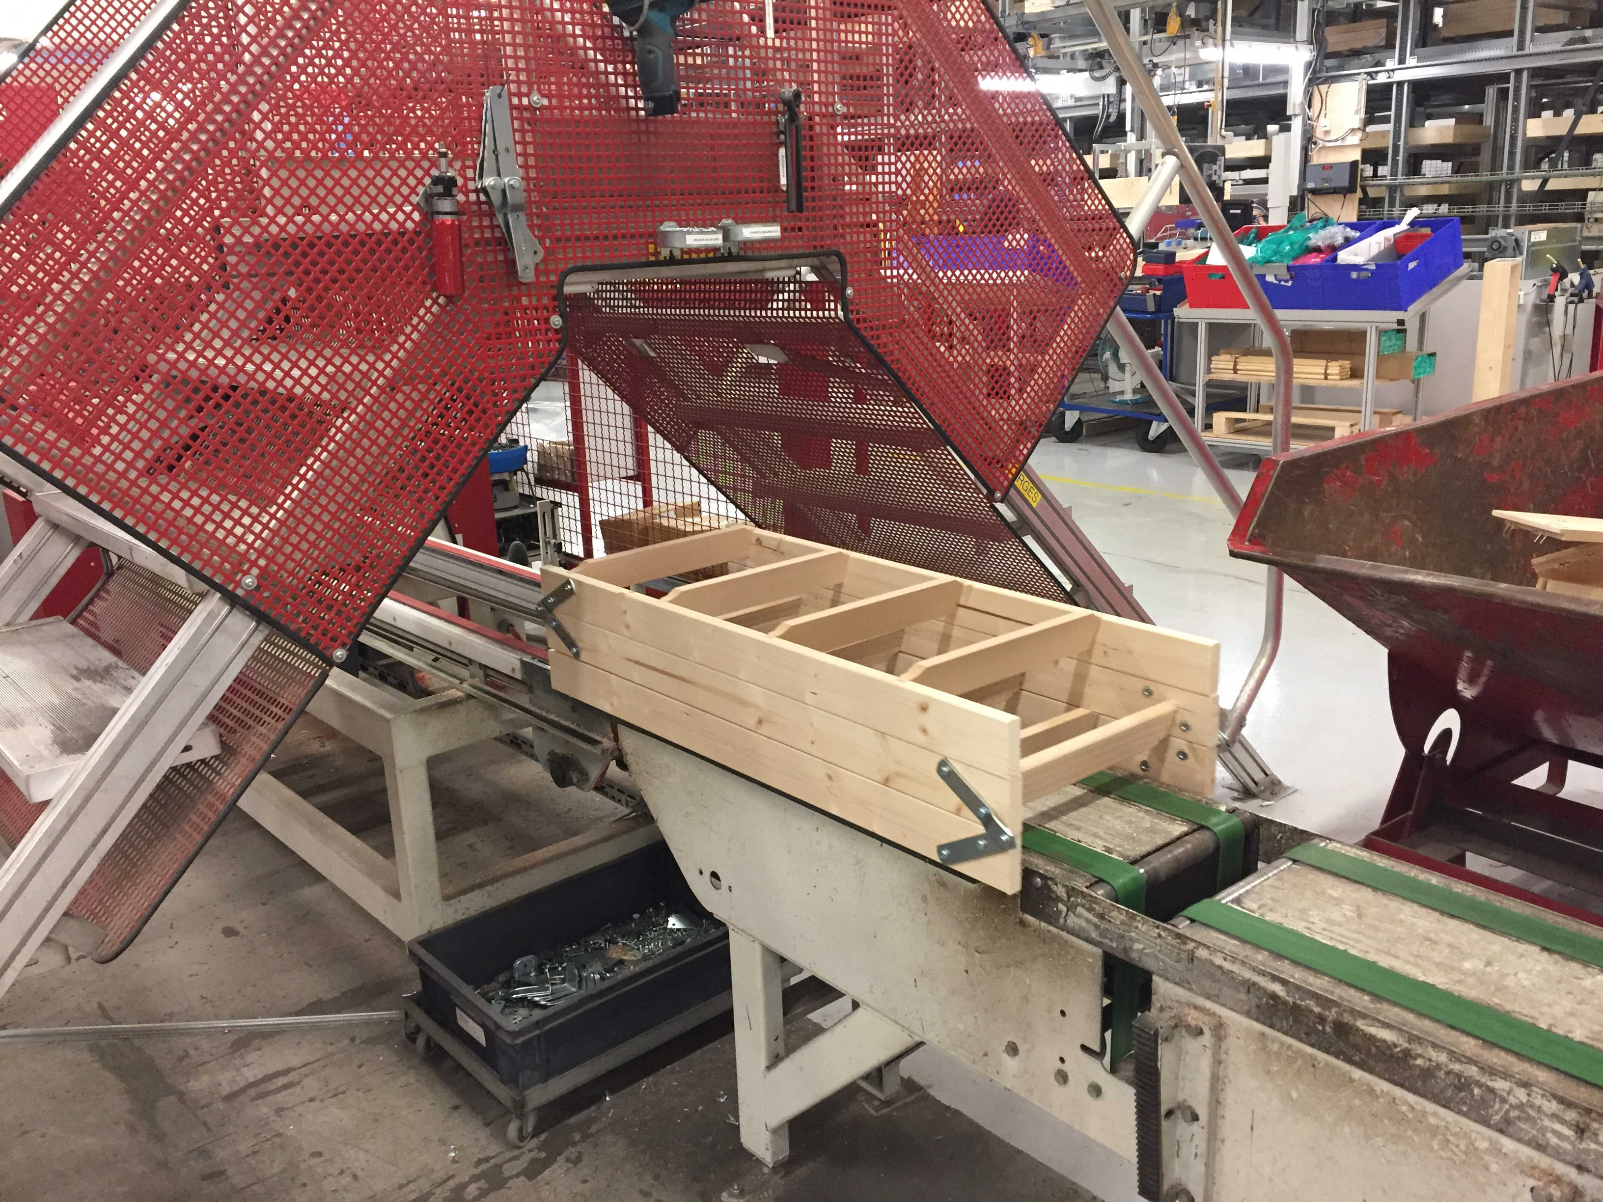
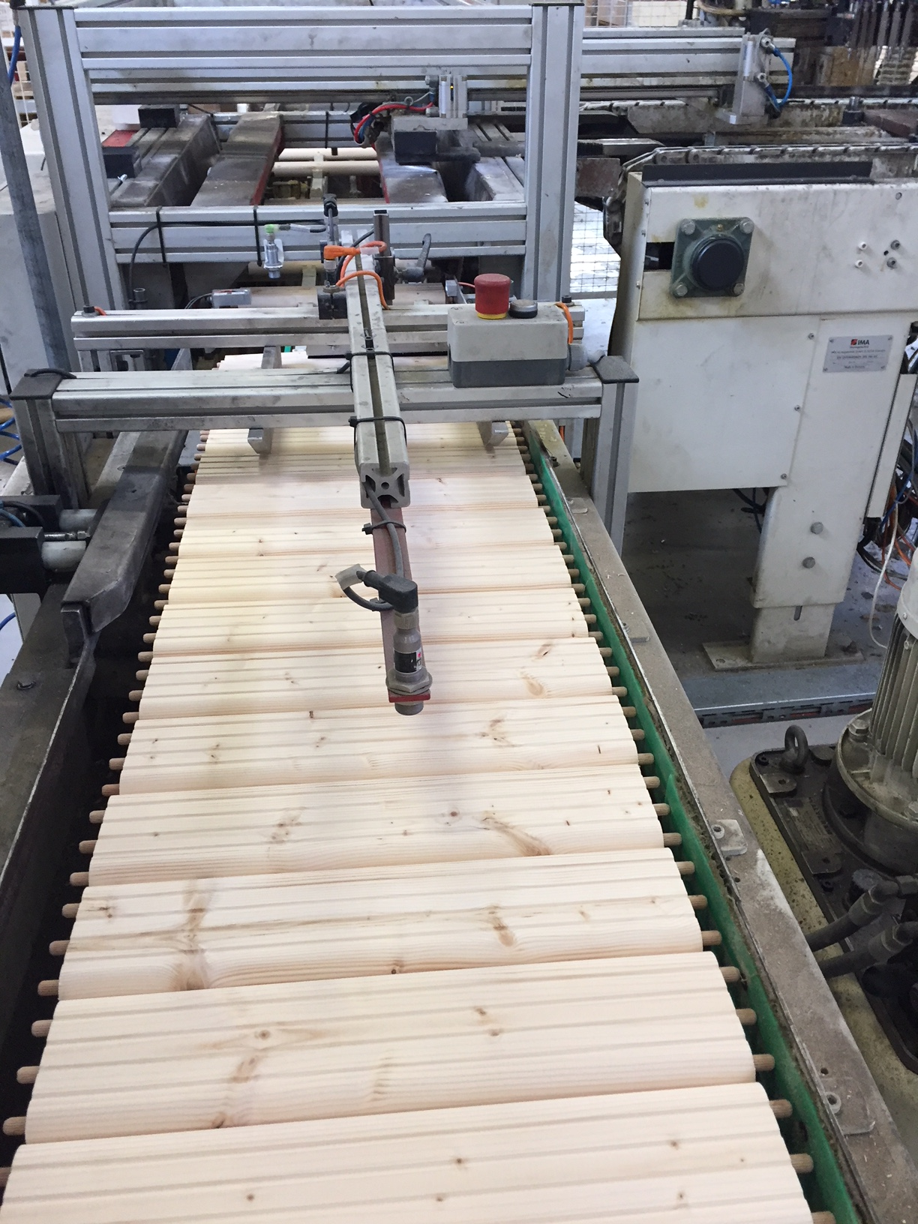
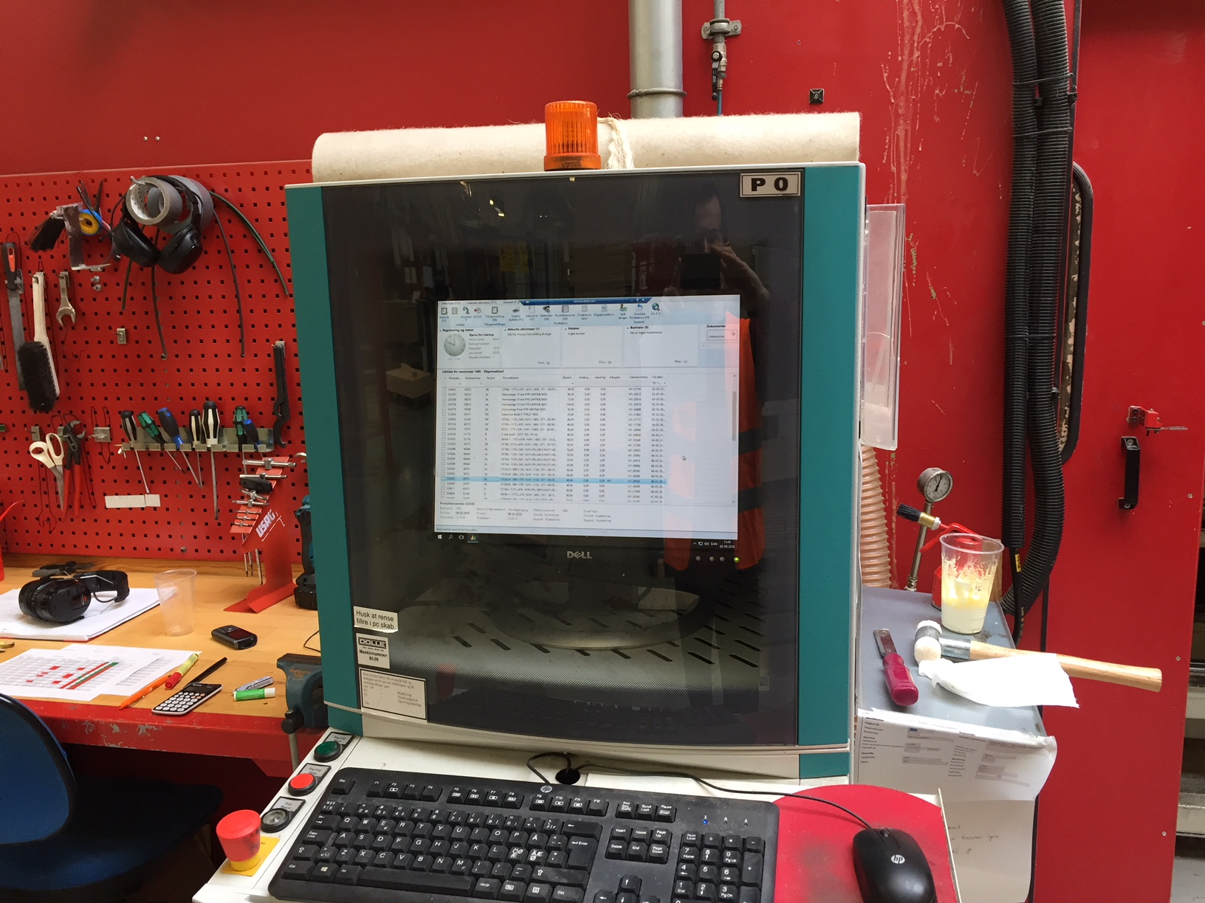
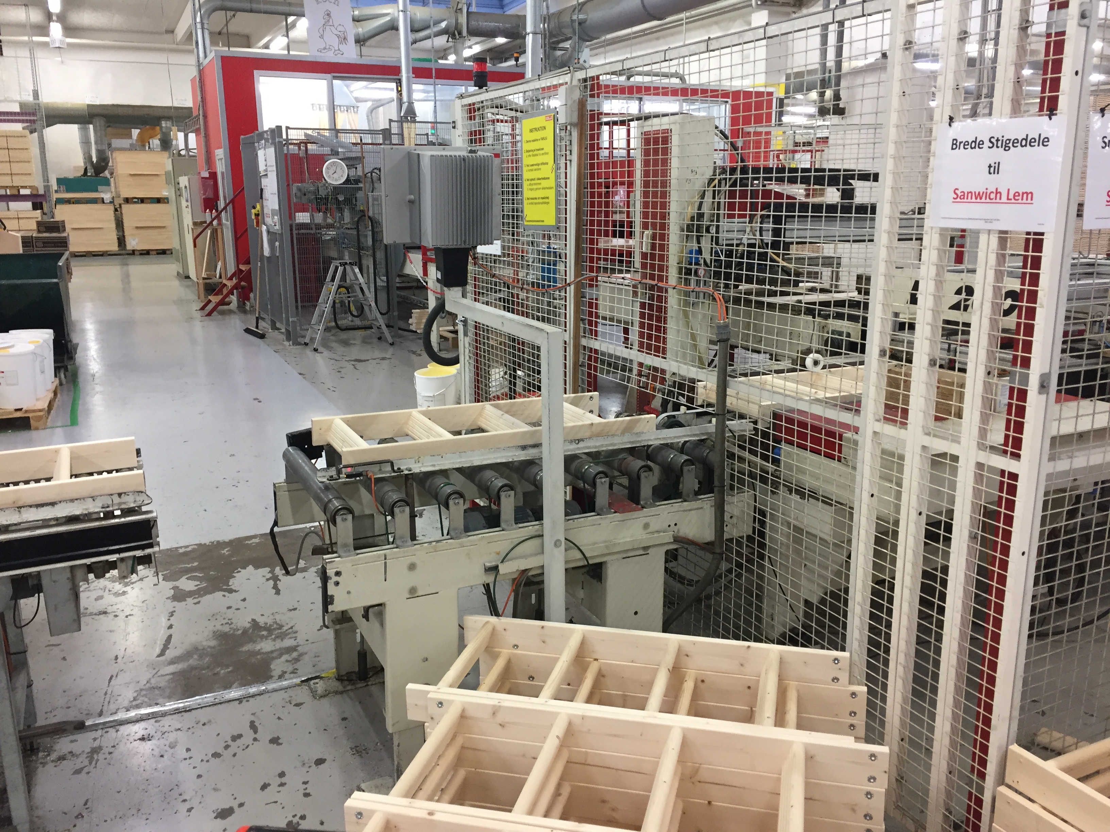

Slide 4
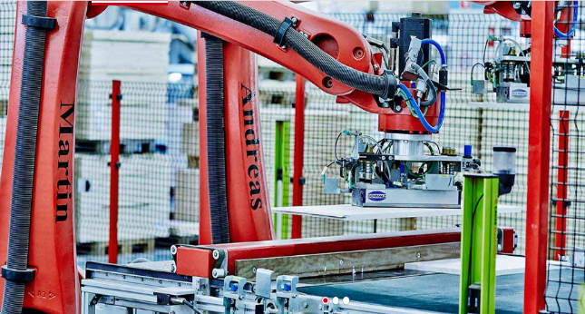
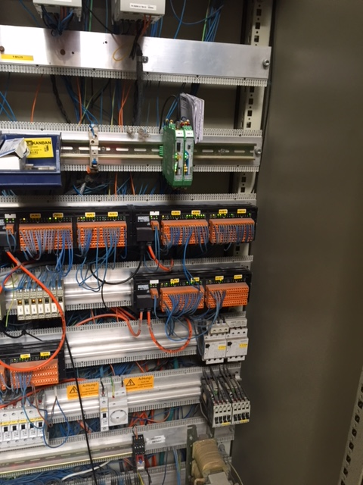
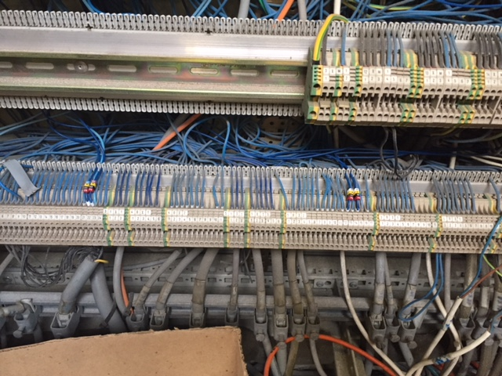

Slide 5
Industry 4.0
What is Industry 4.0?
Internet of Things
Importance of I4.0

Slide 6
Target group
Which companies do we target?
Why these companies?
Why should they join Industry 4.0?

Slide 7
Problem statement
What is the problem companies face with data?
What do they want to do?
Our job here
Kinds of analysis:
1. Descriptive analysis
2. Predictive analysis
3. Near real time/ real time visualisation

Slide 8
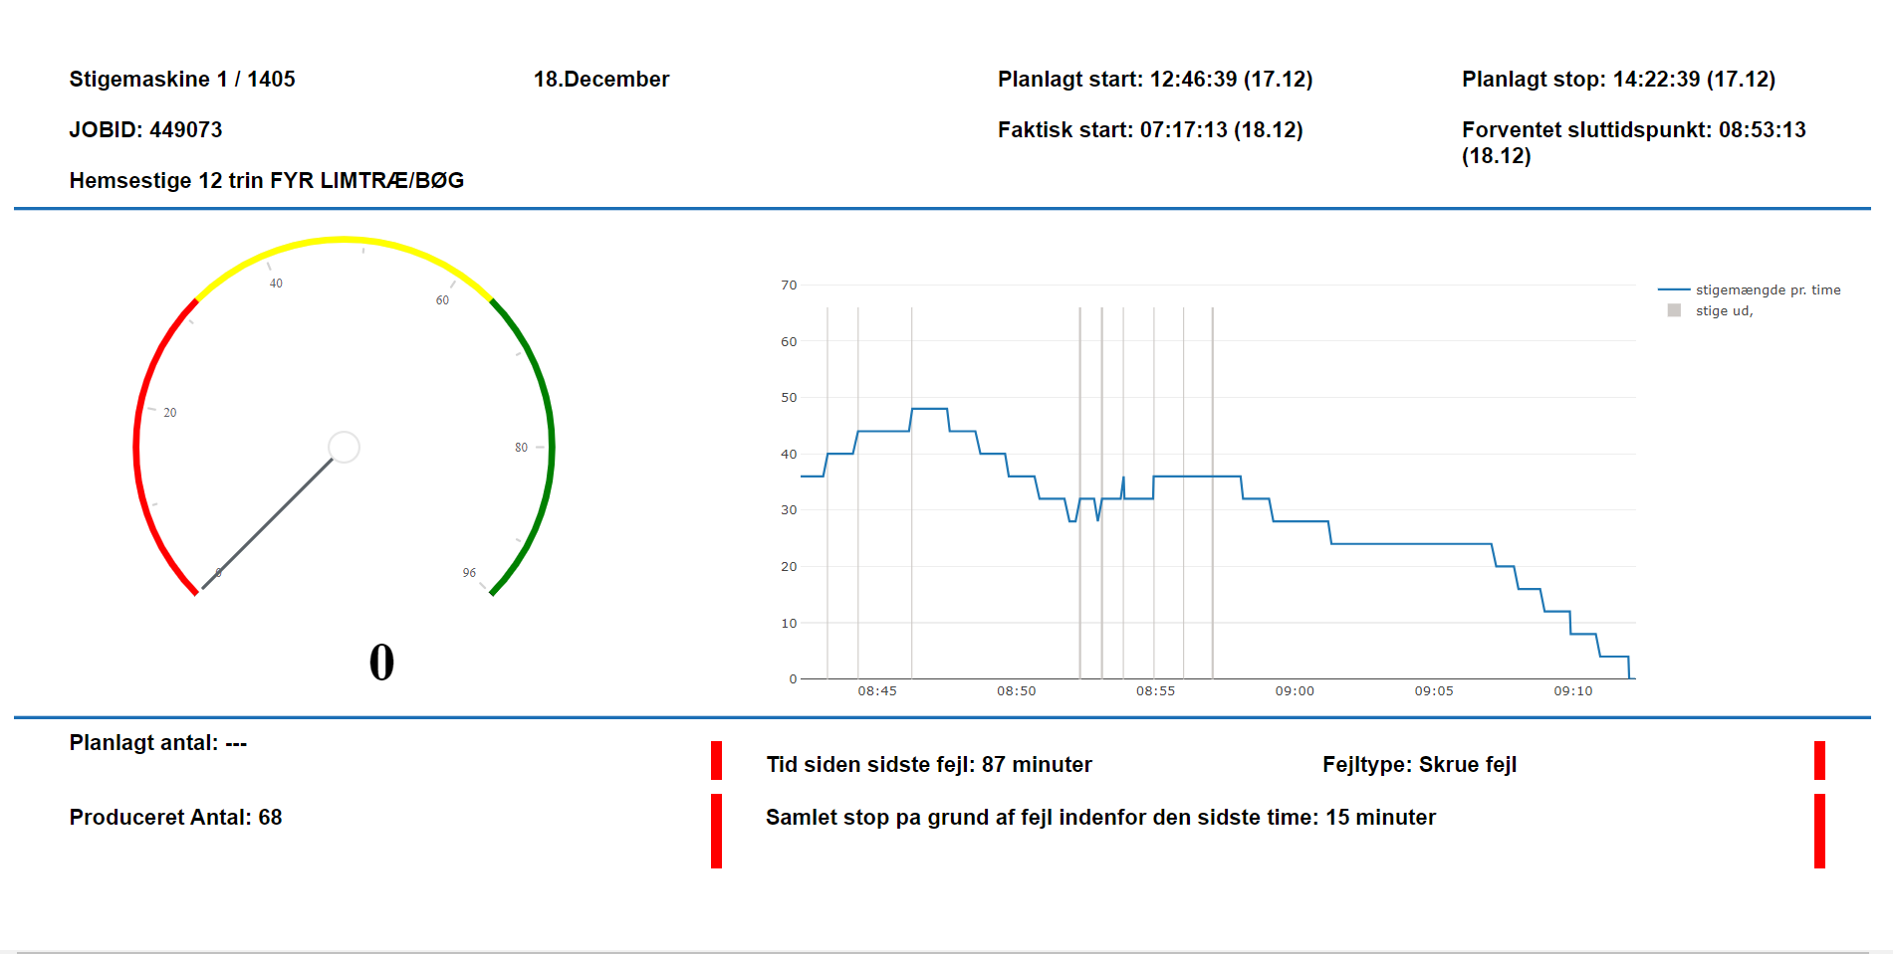

Slide 9
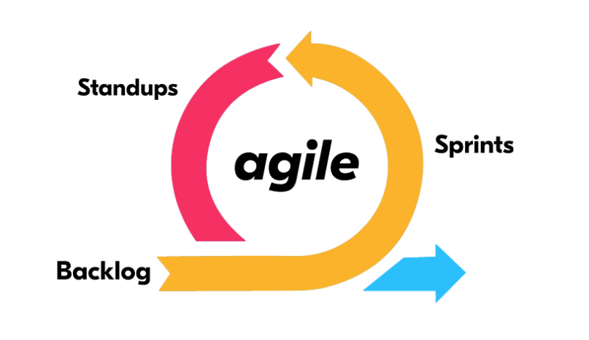
Methodology
Scrum
Extreme programming
Unified process
Kanban
Scrum fit to our project

Slide 10

Versioning/Branching
GitHub
Branches

Slide 11
Data format
SQL (SQL Server)
NoSQL (MongoDB)

Slide 12
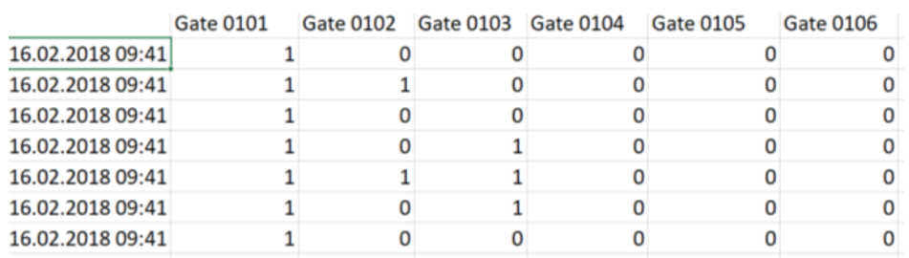
Old data format

Slide 13
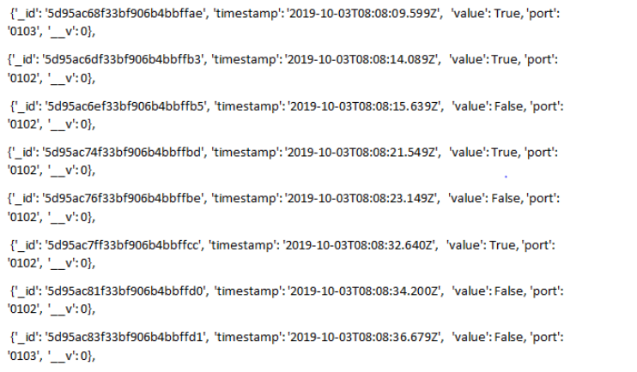
New data format

Slide 14
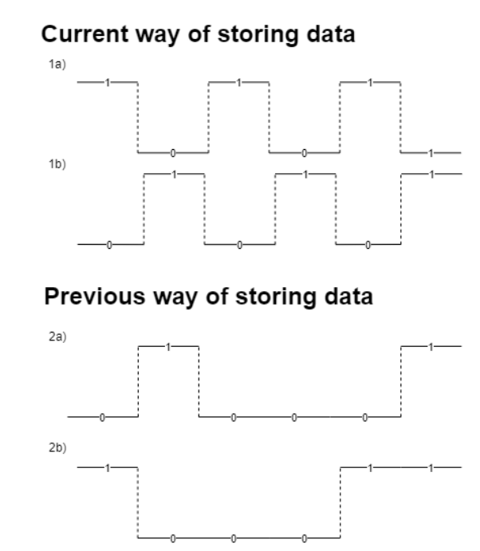
Data difference

Slide 15
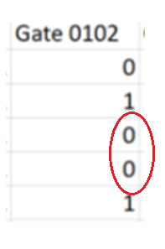
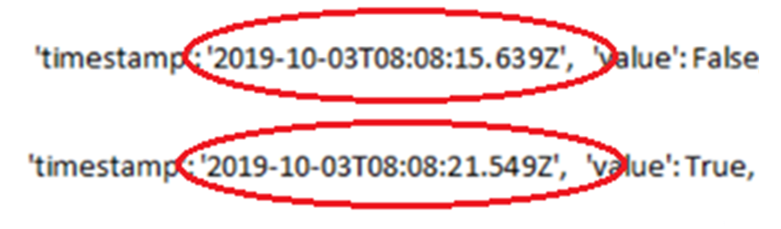
Data redundancy

Slide 16
Accessing the Data
API for data access
Json
Setup of api between database and us

Slide 17
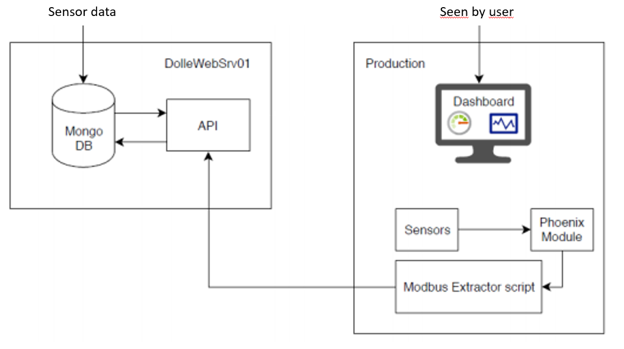
Setup overview

Slide 18
Two main algorithms for display
Number of ladders for period of time
Time elapsed since last sensor read

Slide 19
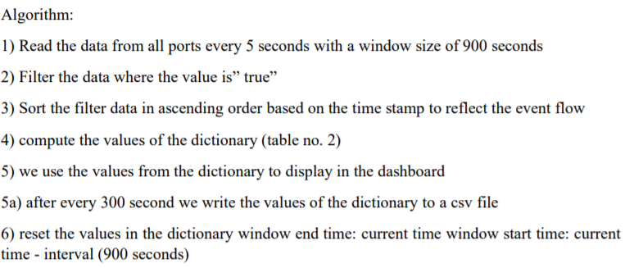
First Algorithm

Slide 20
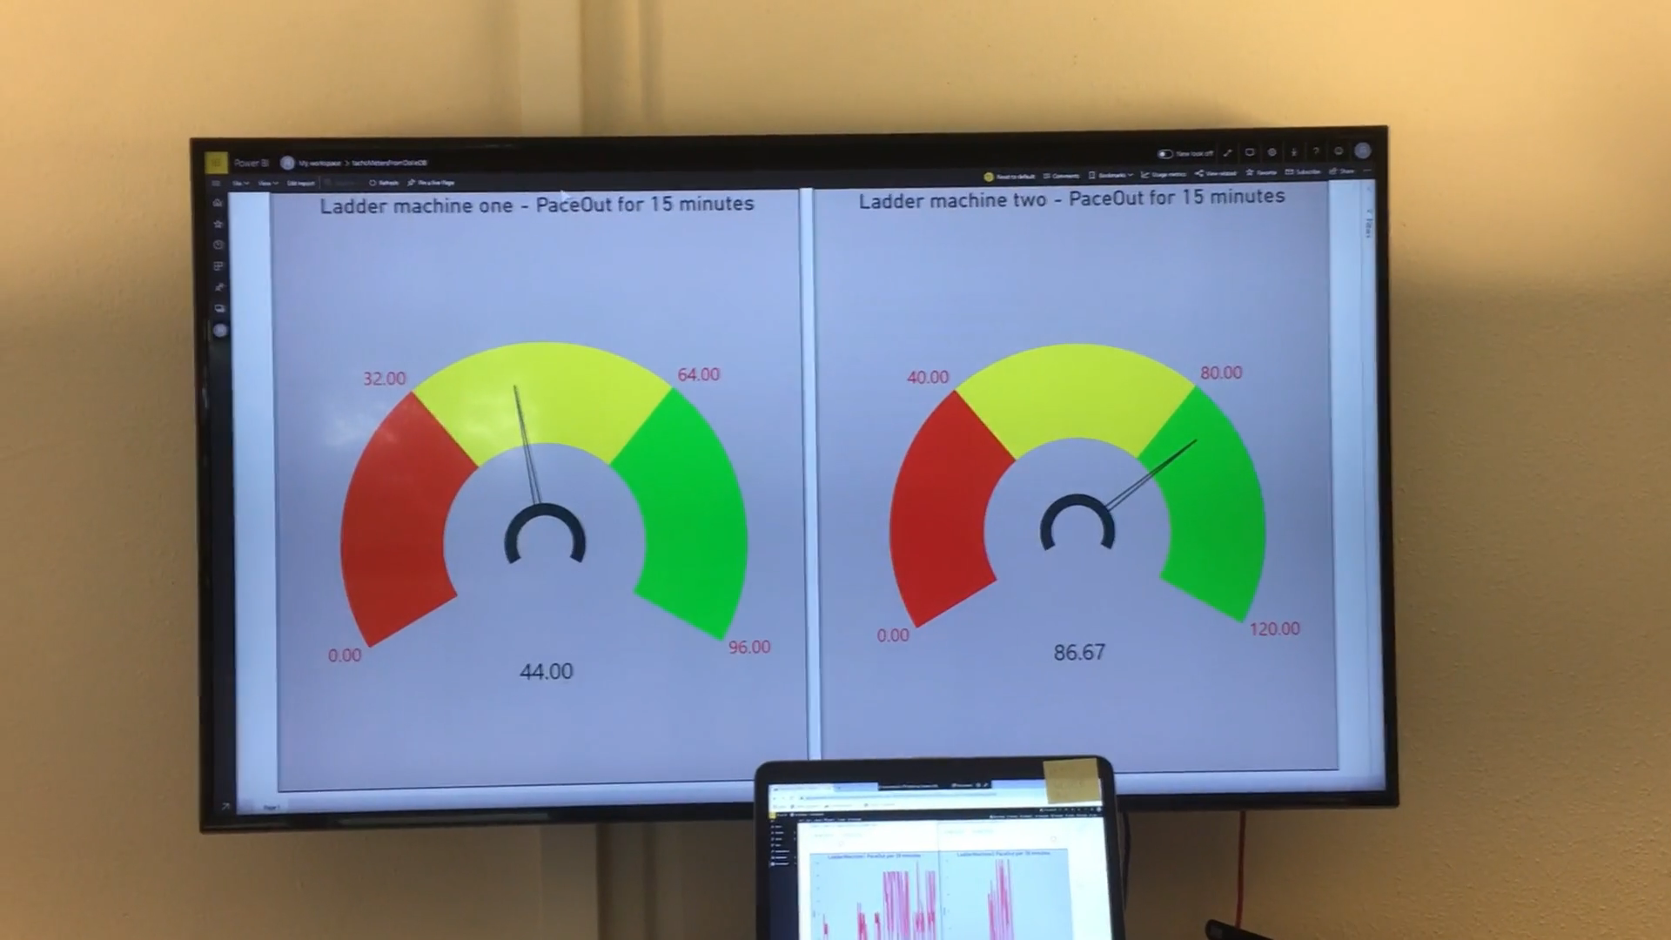

Slide 21
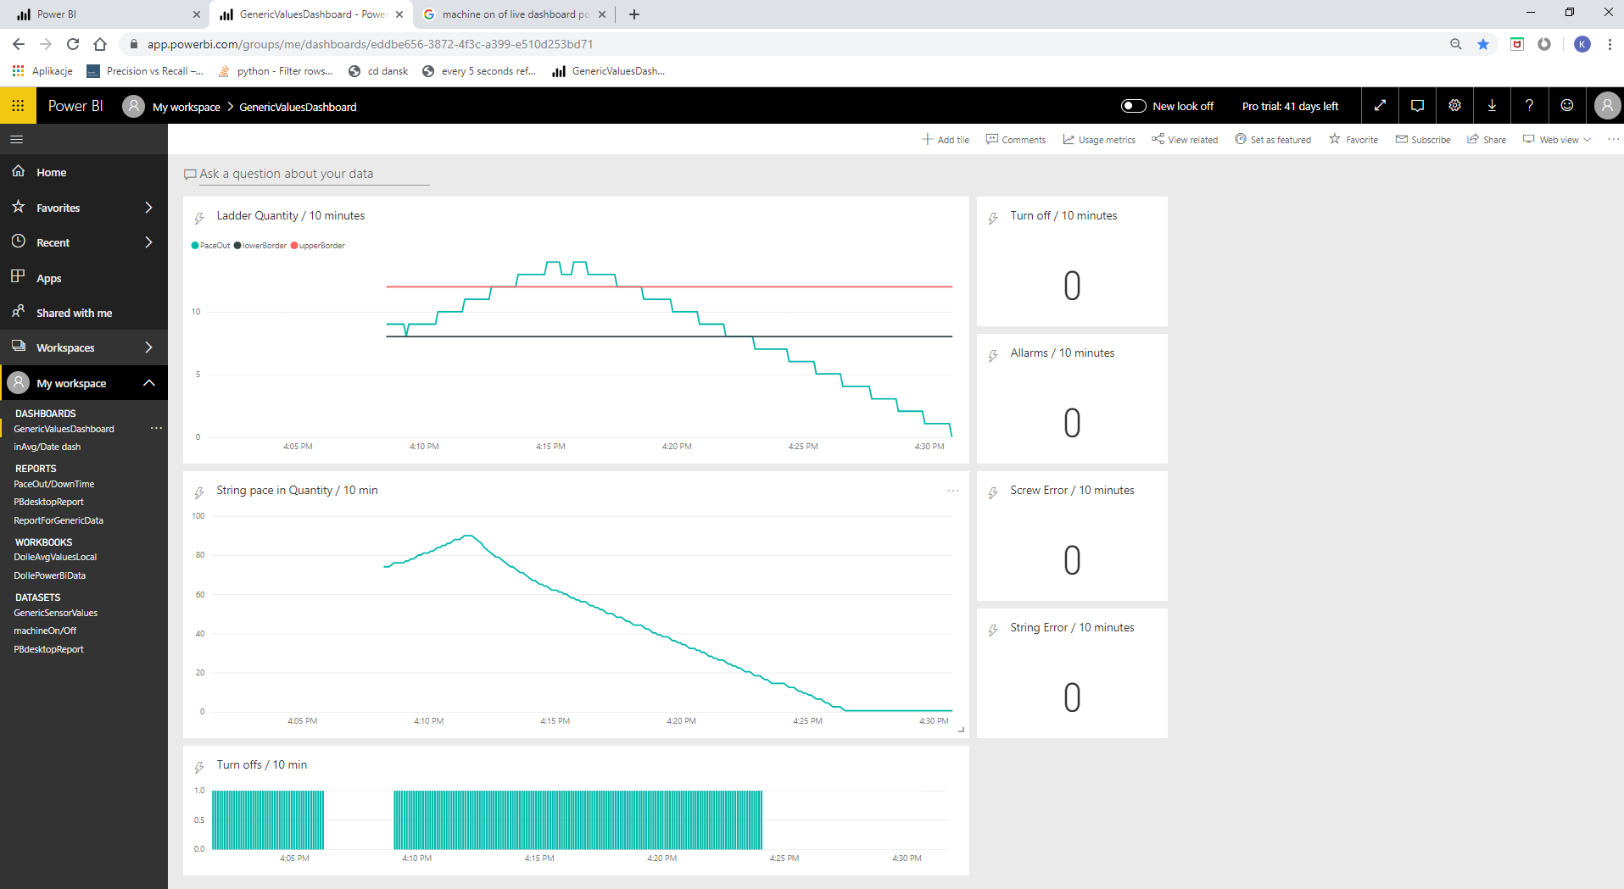
Line chart

Slide 22
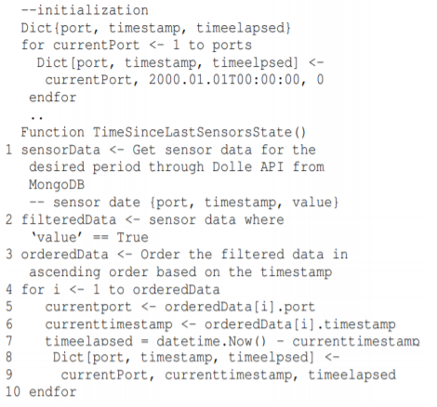
Second Algorithm

Slide 23
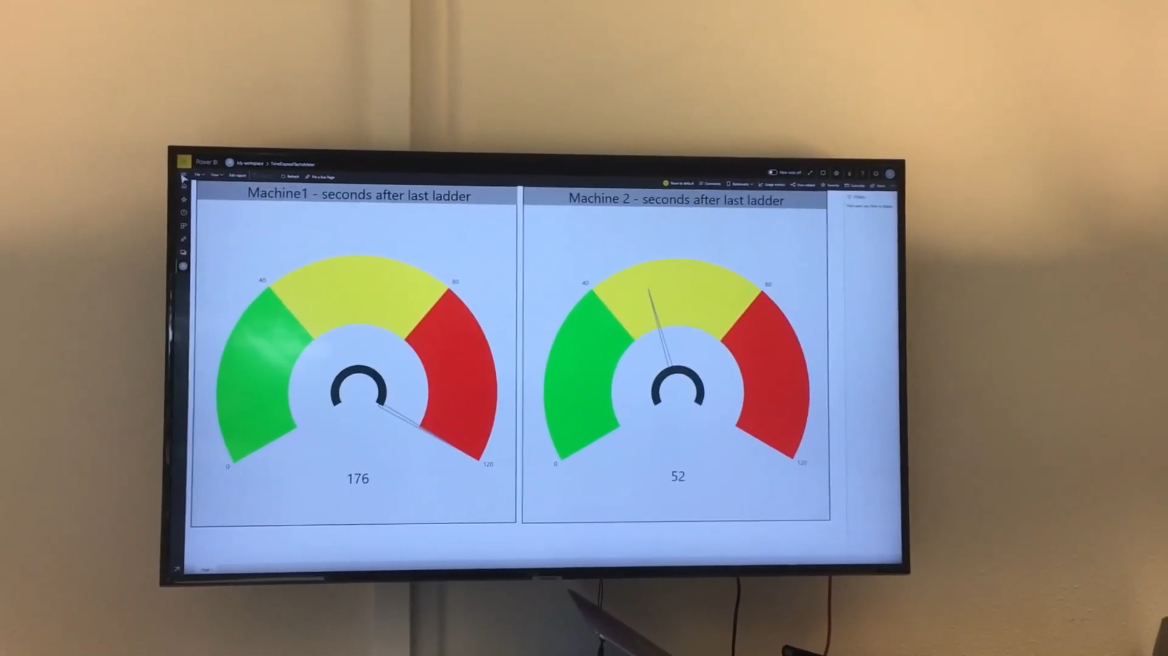

Slide 24
Power BI
System overview
Advantages
Disadvantages
Why it wasn't good enough

Slide 25
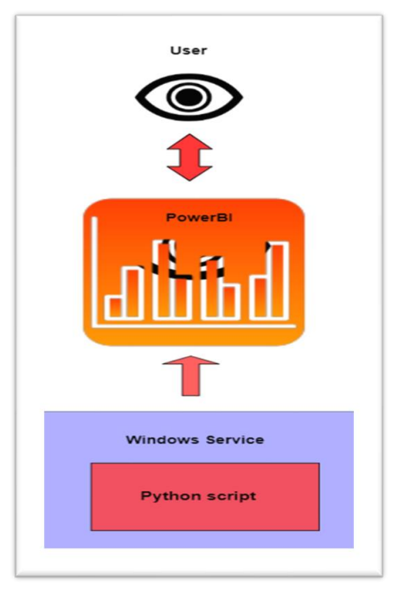
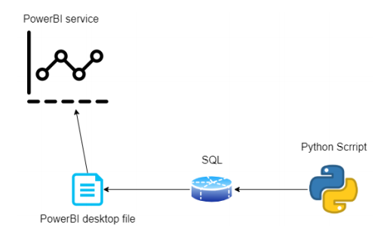
Setup overview

Slide 26
Power BI
System overview
Advantages
Disadvantages
Why it wasn't good enough

Slide 27
Dash
What is Dash?
Why swap to Dash?
ERP
New System overview with Dash
What to use instead of PowerBI?

Slide 28
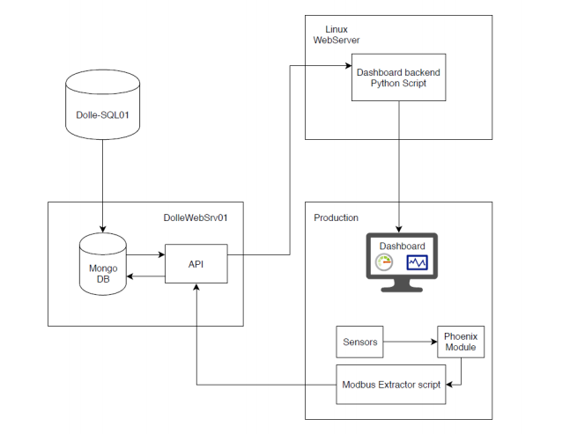
Setup overview
ERP

Slide 29
Deployment
Deploying the product onto Dolle's platform
Documentation of system

Slide 30
Different ways of testing
Data integrity
Testing in real production line
Testing system stability
Logging and event testing
Feedback testing

Slide 31
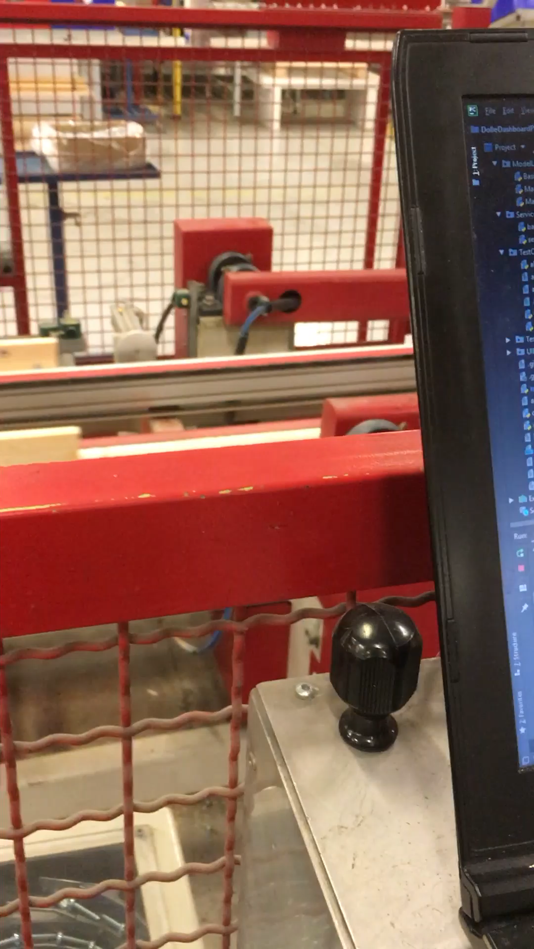

Slide 32
Academical knowledge used
Data analysis
System designing
Object oriented programming
Web
Stakeholder communication

Slide 33

What we learnt ?
Day to day operation of Dolle
Real life hierarchy
Working in Corporation – scheduling meetings
Flow manufacturing engineering
Industry 4.0
Present, argue and develop ideas (Switching to dash)
Create solutions for assesed problems
Security

Slide 34
Future work
Others Machines
Analysis of vibration data
Machine learning

Slide 35

Break - stop

Slide 36
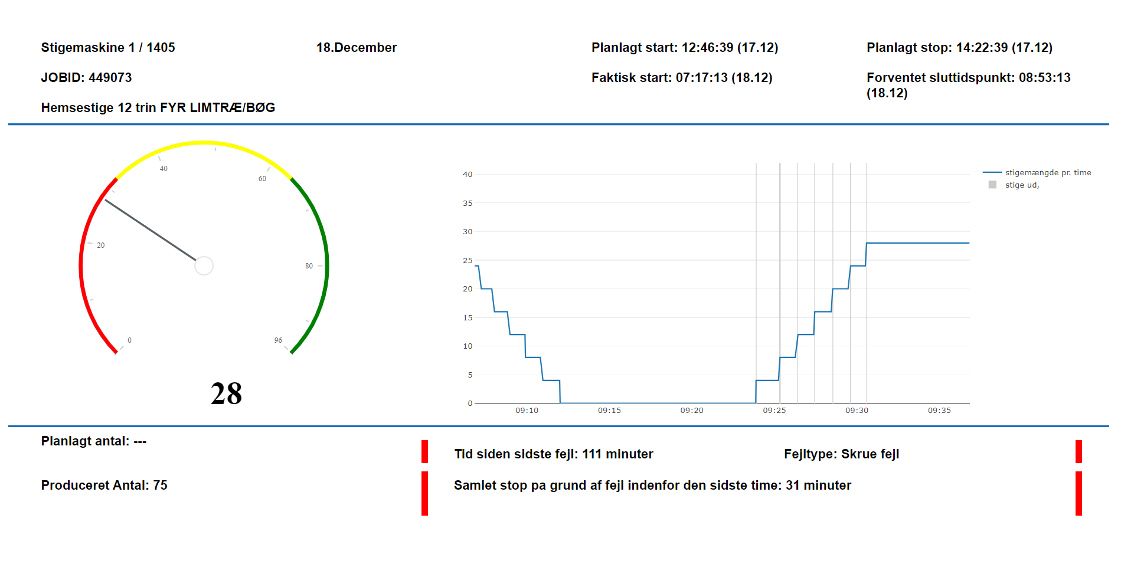
Break - start

Slide 37
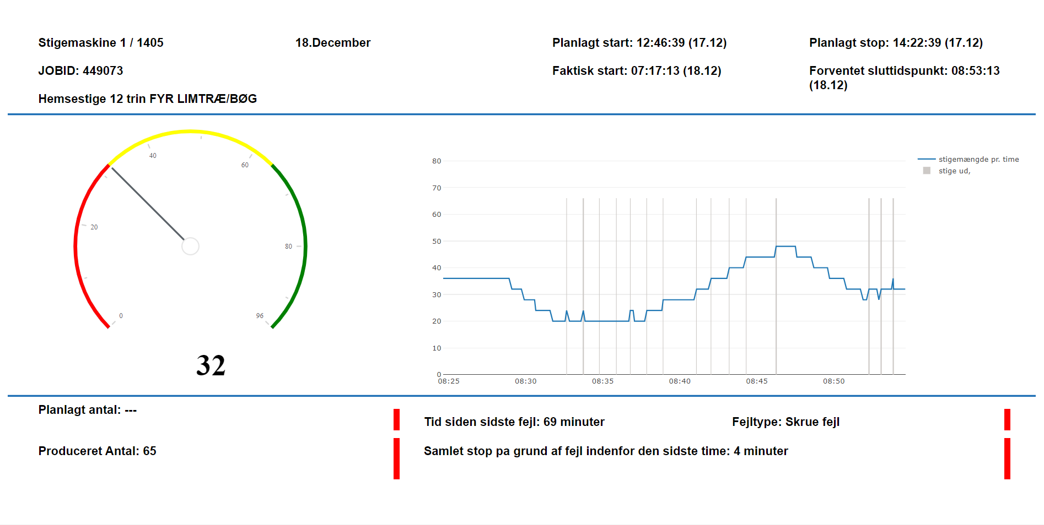
Break in production

Slide 38
Unwanted machine breakdown

Slide 39
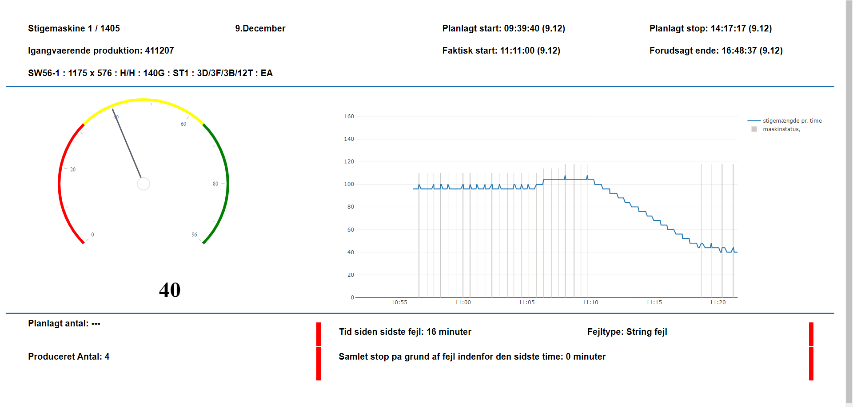
Job Switch

Slide 40
Thank you

Slide 41
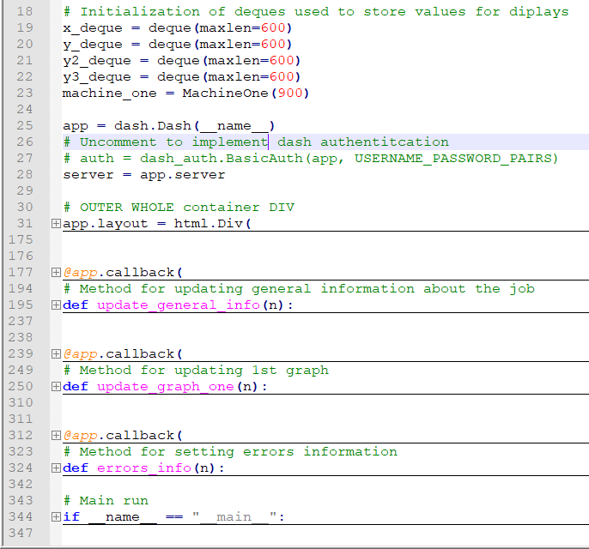
Dash app structure

Slide 42
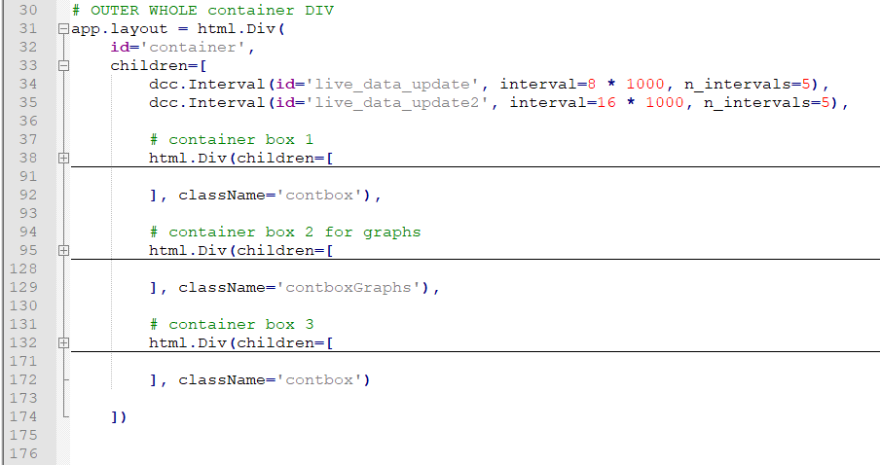

Slide 43
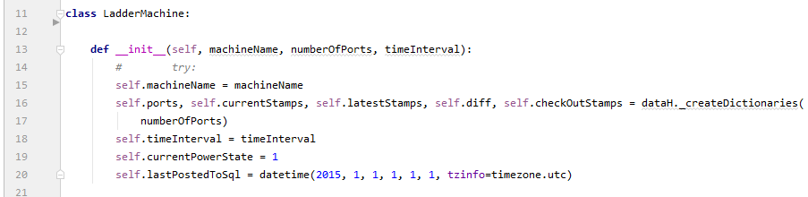
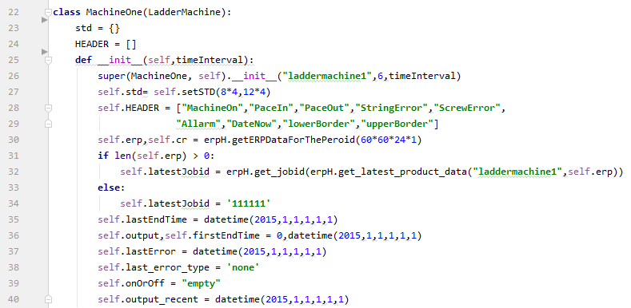
Parent class – general machine
Child class – specific machine

